Slide 1
BUDDY SYSTEM及其应用
陈志磊

Slide 2
01
Buddy system的介绍
02
优缺点
03
buddy system的应用
04
参考文献

Slide 3

01
Buddy system的介绍
buddy system内存管理，结合使用fixed partition和un-fixed partition，努力让内存分配与相邻内存合并能快速进行，它利用的是计算机擅长处理2的幂运算。
Fixed 内存块的大小必须是$2^{order}$ 因此块单元在内存中的地址能被其 大小整除
Un-fixed 一个大的内存块可以被分割为相同大小的2块，这两块就互为伙 伴

Slide 4
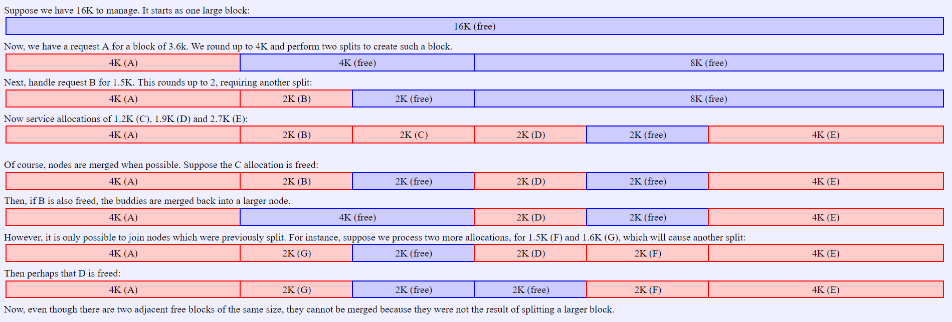
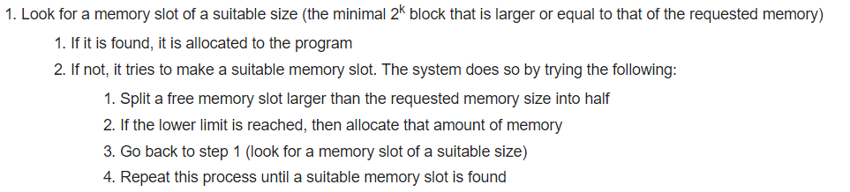
内存的分配

Slide 5
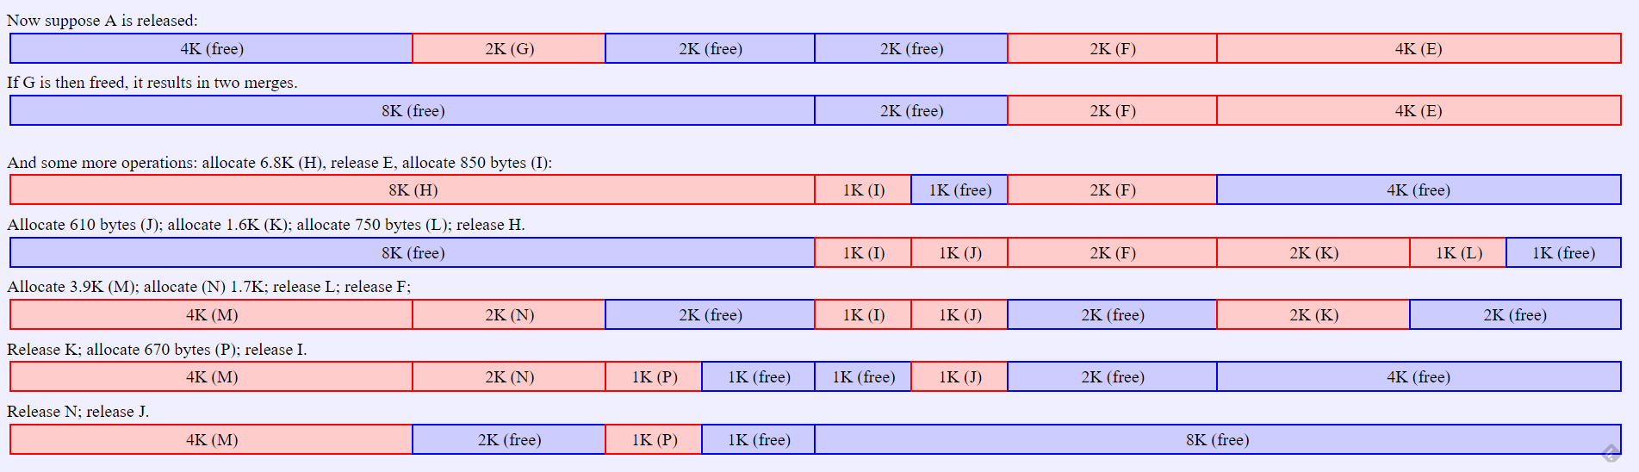

内存的释放

Slide 6
02
优缺点
Advantage：实现简单、执行速度很快
Disadvantage：会有大量空间碎片

Slide 7
03
buddy system的应用
Buddy system主要的应用就是linux的内存管理和分配。
Manage free blocks
Allocate pages
Free pages

Slide 8
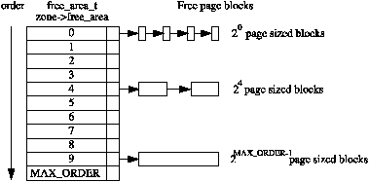
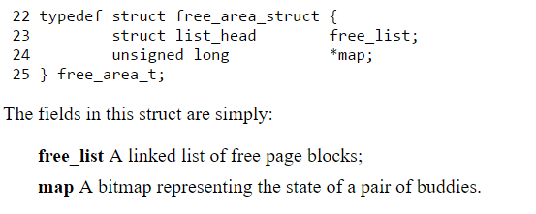
Manage free blocks
The allocator maintains blocks of free pages where each block is a power of two number of pages.The exponent for the power of two sized block is referred to as the order. An array of free_area_t structs are maintained for each order that points to a linked list of blocks of pages that are free

Slide 9
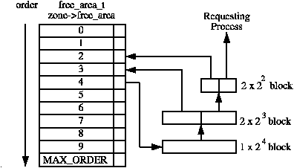
Allocate pages
If a free block cannot be found of the requested order, a higher order block is split into two buddies. One is allocated and the other is placed on the free list for the lower order.

Slide 10
Free pages
When a buddy is freed, Linux tries to coalesce the buddies together immediately if possible.
Linux checks the bit corresponding to the affected pair of buddies in free_area→map.
If the bit in the map is 0 after toggling, we know that the other buddy must also be
free. Then merge them.
Once the buddy is merged, it is removed for the free list and the newly coalesced pair moves to the next higher order to see if it may also be merged.

Slide 11
04
参考文献
[1] Kenneth C. Knowlton. A fast storage allocator. Communications of the ACM, 8(10):623–624, 1965.
[2] 焦莉娟．浅析伙伴系统的分配与回收． 科技情报开发与经济．2005.15.252-253
[3] The Linux Kernel Archives.Chapter 6 Physical Page Allocation. https://www.kernel.org/doc/gorman/html/understand/understand009.html
[4] Google

Slide 12
THANK YOU!

